Slide 1
MGT10009 Contemporary Management Principles
Lecture 9 Planning & Strategic Mgt
Dr David Qian dqian@swin.edu.au
Peter Moran pmoran@swin.edu.au
Notes:
1

Slide 2
Learning Objectives
4-1 Summarize the basic steps in any planning process.
4-2 Describe how to integrate strategic planning with tactical and operational planning.
4-3 Identify elements of the external environment and internal resources of the firm to analyze before formulating a strategy.
4-4 Define core capabilities and explain how they provide the foundation for business strategy.
4-5 Summarize the types of choices available for corporate strategy.
4-6 Discuss how companies can achieve competitive advantage through business strategy.
4-7 Describe the keys to effective strategy implementation.

Slide 3
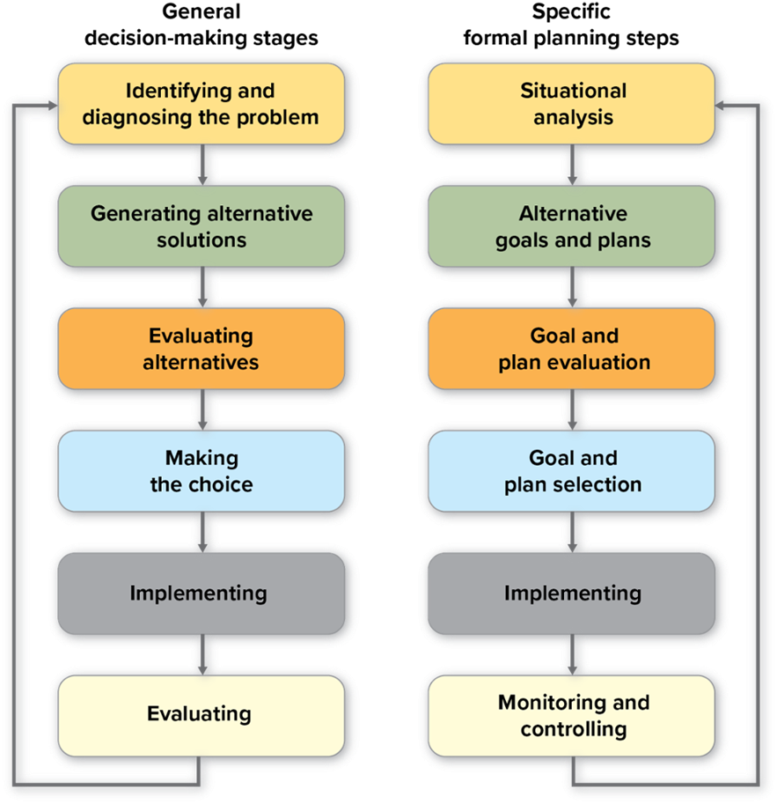
Exhibit 4.1 Decision-Making Stages and Formal Planning Steps
Access the text alternative for slide images.
Notes:
It is important to understand why decision making can be so challenging. Exhibit 3.1 illustrates several characteristics of managerial decisions that contribute to their difficulty and pressure.

Slide 4

The Basic Planning Process
Step 1: Situational Analysis.
Step 2: Alternative Goals and Plans.
Step 3: Goal and Plan Evaluation.
Step 4: Goal and Plan Selection.
Step 5: Implementing.
Step 6: Monitoring and Controlling.
Notes:
This slide repeats the planning steps.

Slide 5

Step 1: Situational Analysis
A process planners use to gather, interpret, and summarize all information relevant to the planning issue under consideration.

Slide 6

Step 2: Alternative Goals and Plans
Goals:
The targets or ends that management desires to reach.
Plans:
The actions or means managers intend to use to achieve organizational goals.
Contingency plans are “what if” plans.
Notes:
Based on the situational analysis, the planning process should generate multiple goals that could be pursued and various plans for achieving them. This step should stress creativity and encourage managers and employees to think broadly about their work.
Goals are the targets or ends the manager wants to reach. Plans are the actions or means the manager intends to use to achieve goals.
At a minimum, plans should outline alternative actions attaining each goal, the resources required to reach the goal through those means, and the obstacles that may develop.

Slide 7

Step 3: Goal and Plan Evaluation
Managers evaluate the advantages, disadvantages, and potential effects of each goal and plan.
Managers prioritize those goals and eliminate some of them.
Managers consider carefully the implications of alternative plans for meeting high-priority goals.
Notes:
In particular, they will pay a great deal of attention to the cost of any initiative and the predicted return on investment.

Slide 8

Step 4: Goal and Plan Selection
Managers will select the option that is most appropriate and feasible.
The evaluation process helps identify the priorities and trade-offs among the goals and plans.
Planning scenarios are generated.
Firm anticipates and manages problems and allows greater flexibility and responsiveness.
Notes:
Once managers have assessed the various goals and plans, they try to select the best. The evaluation process helps to identify trade-offs and decide what to do.
Scenario: a narrative that describes a particular set of future conditions.

Slide 9

Step 5: Implementing
Managers and employees must understand the plan and have the resources and motivation to implement it.
Successful implementation requires a plan to be linked to other systems in the organization, particularly the budget and reward systems.
Notes:
Once managers have assessed the various goals and plans, they try to select the best. The evaluation process helps to identify trade-offs and decide what to do.
Scenario: a narrative that describes a particular set of future conditions.

Slide 10
Step 6: Monitoring and Controlling
Managers must:
Continually monitor the actual performance of their work units against the unit’s goals and plans.
Develop control systems to measure that performance and allow them to take corrective action.
Notes:
Without monitoring, you will never know whether your plan is succeeding.

Slide 11
SPOTLIGHT ON… Novo Nordisk Monitors Progress with Its Triple Bottom Line
Novo Nordisk follows a Triple Bottom Line (T B L) strategy, meaning decisions are based on the belief that “a healthy economy, environment, and society are fundamental to long-term business success.”
To ensure that the T B L philosophy would stick, Novo Nordisk took the uncommon step of incorporating it into their company bylaws.
Notes:
The discussion of the social enterprise can be extended these questions.
1. Why do you think more companies don’t incorporate a TBL philosophy into their bylaws?
2. Assume you want your employer to consider adopting a TBL philosophy. How would you pitch the idea? With whom would you speak?

Slide 12
Strategic Planning
Strategic planning:
Set of procedures for making decisions about the organization’s long-term goals and strategies.
Strategic goals:
Major targets or end results that relate to the long-term survival, value, and growth of the organization.
Strategy:
A pattern of actions and resource allocations designed to achieve organization goals.
Notes:
In Chapter 1, you learned about the three major types of managers: top-level (strategic managers), middle-level (tactical managers), and frontline (operational managers). Because planning is an important management function, managers at all levels engage in it. However, the scope and activities of the planning process differ at different levels.
A strategy is a pattern of actions and resource allocations designed to achieve the goals of the organization .

Slide 13
Exhibit 4.2 Effective Strategies Answer Five Questions
Effective Strategies Answer Five Questions
1. Where will we be active?
2. How will we get there (for example, by increasing sales or acquiring another company)?
3. How will we win in the market (for example, by keeping prices low or offering the best service)?
4. How fast will we move and in what sequence will we make changes?
5. How will we obtain financial returns (low costs or premium prices)?

Slide 14
Exhibit 4.3 Hierarchy of Goals and Plans
Goals and Plans | Managerial Level | Level of Detail | Time Horizon
Strategic | Top | Low | Long (3-7 years)
Tactical | Middle | Medium | Medium (1-2 years)
Operational | Frontline | High | Short (<1 year)

Slide 15

Tactical and Operational Planning
Tactical planning:
Set of procedures for translating broad strategic plans into specific goals and plans that are relevant to a distinct portion of the organization, such as a functional area like marketing.
Operational planning:
The process of identifying the specific procedures and processes required at lower levels of the organization.
Notes:
Tactical planning translates broad strategic goals and plans into specific goals and plans that are relevant to a particular unit in the organization, often a functional area like marketing or human resources. Tactical plans focus on the major actions a unit must take to fulfill its part of the strategic plan.
Operational planning identifies the specific procedures and processes required at lower levels of the organization. Frontline managers usually focus on routine tasks such as production runs, customer service product updates, delivery schedules, and human resources.

Slide 16
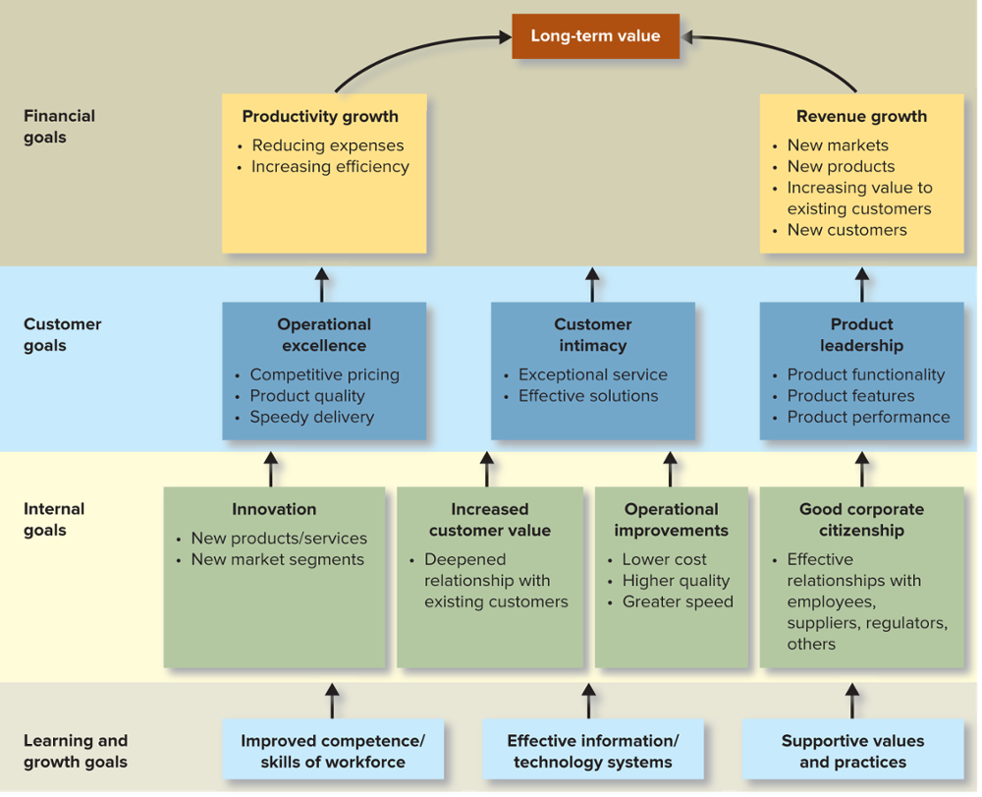
Exhibit 4.4 The Strategy Map: Creating Value by Aligning Goals
SOURCES: Adapted from R. Kaplan and D. Norton, “Plotting Success with Strategy Maps,” Optimize, February 2004, http://www.optimizemag.com; R. Kaplan and D. Norton, “Having Trouble with Your Strategy? Then Map It,” Harvard Business Review, September–October 2000.
Notes:
Exhibit 4.4 shows a strategy map and how the various goals of the organization relate to each other to create long-term value for the firm.

Slide 17
Exhibit 4.5 The Strategic Management Process
A process that involves managers from all parts of the organization in the formulation and implementation of strategic goals and strategies.
Notes:
Because of these trends, firms often use the term strategic management to describe the process. Strategic management involves managers from all parts of the organization in the formulation and implementation of strategic goals and strategies. It integrates strategic planning and management into a single process and uses a SWOT analysis.

Slide 18
Step 1: Establishing Mission, Vision, and Goals
Mission:
An organization’s basic purpose and scope of operations.
Strategic Vision
The long-term direction and strategic intent of a company.
Provides a perspective on where the organization is headed and what it can become.
Notes:
The first step in strategic planning is establishing a mission, a vision, and goals for the organization. The mission is a clear and concise expression of the basic purpose of the organization. It describes what the organization does, for whom it does it, its basic good or service.
The strategic vision points to the future—it provides a perspective on where the organization is headed and what it can become. Ideally, the vision statement clarifies the long-term direction of the company and its strategic intent.

Slide 19
Step 2: Analyzing External Opportunities and Threats
Stakeholders
Groups and individuals who affect and are affected by the achievement of the organization’s mission, goals, and strategies.
Some view renewable resources as a threat; others as an opportunity.
Notes:
Stakeholders include buyers, suppliers, competitors, government and regulatory agencies, unions and employee groups, the financial community, owners and shareholders, and trade associations. The environmental analysis assesses these stakeholders and the ways they influence the organization. The environmental analysis also should examine other forces in the environment, such as economic conditions and technological factors.

Slide 20
Components of an Environmental Analysis
COMPONENTS
Industry and Market Analysis
Competitor Analysis
Political and Regulatory Analysis
Social Analysis
Human Resources Analysis
Macroeconomic Analysis
Technological Analysis
Notes:
Exhibit 4.6 is abbreviated on the slide. The important activities in an environmental analysis include the ones shown here.

Slide 21
Step 3: Analyzing Internal Strengths and Weaknesses
Internal resource analysis:
Financial analysis.
Marketing audit.
Operations analysis.
Other internal resource analysis.
Human resources assessment.
Notes:
As managers conduct an external analysis, they also assess the strengths and weaknesses of major functional areas inside their organization. Exhibit 4.7 lists some of the major components of this internal resource analysis.

Slide 22
Resources and Core Capabilities
Resources:
Inputs to a system that can enhance performance.
Tangible assets: real estate, raw materials.
Intangible assets: reputation, culture, patents.
Core Capability:
Unique skill and/or knowledge an organization possesses that gives it an edge over competitors.

Slide 23
Exhibit 4.8 Resources and Core Capability
Notes:
A resource provides advantage if it is instrumental in creating customer value—increasing the benefits customers derive from a good or service relative to the costs they incur. Second, resources are a source of advantage if they are rare and not equally available to all competitors. Even for extremely valuable resources, if all competitors have equal access, the resource cannot provide competitive advantage. Third, resources provide competitive advantage if they are difficult to imitate. Fourth, the resources must be organized.

Slide 24
Benchmarking
Benchmarking:
Process of assessing how well one company’s basic functions and skills compare with those of an another.
Goals of benchmarking:
Understand the “best practices” of other firms.
Undertake actions to achieve both better performance and lower costs.
Notes:
An important bias that inhibits benchmarking is the Not Invented Here (NIH) syndrome: a negative attitude toward knowledge (ideas, technologies) derived from an external source.

Slide 25
Step 4: SWOT Analysis and Strategy Formulation
SWOT analysis:
A comparison of strengths, weaknesses, opportunities, and threats that helps executives formulate strategy.
Strengths and weaknesses refer to internal sources.
Opportunities and threats refer to external sources and arise in the macroenvironment and competitive environment.
Notes:
Strengths (internal)
Weaknesses (internal)
Opportunities (external)
Threats (external)

Slide 26
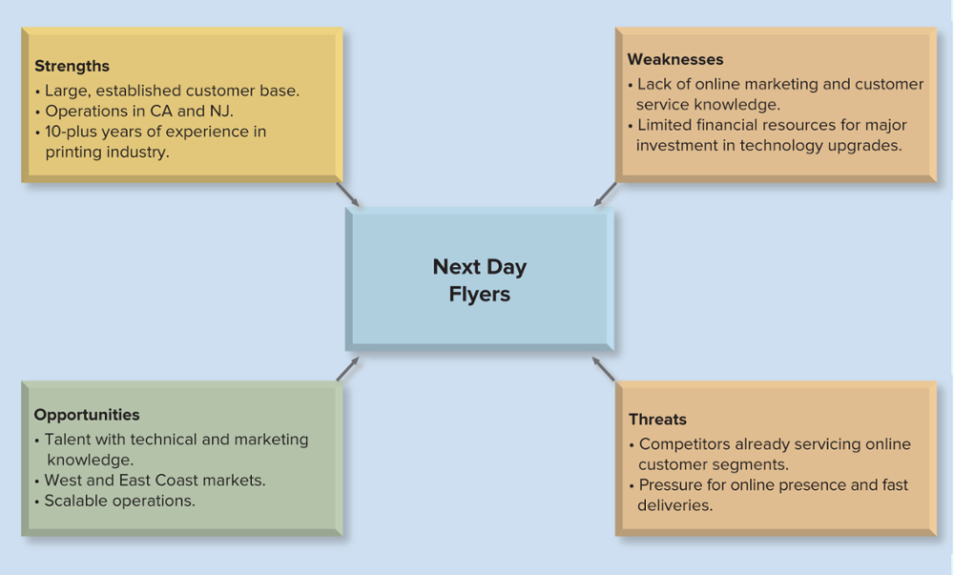
Exhibit 4.9 Sample SWOT Analysis: Next Day Flyers
SOURCES: Based on information from R. Myers, “That Sounds Like a Plan,” Inc. 36 (2014), pp. 90–92; and Next Day Flyers company website, “About Next Day Flyers,” http://www.nextdayflyers.com.
Notes:
Once managers have analyzed the external environment and the internal resources of the organization, they have the information they need to assess the organization’s strengths, weaknesses, opportunities, and threats. SWOT analysis helps managers summarize the relevant, important facts from their external and internal analyses.

Slide 27

Corporate Strategy 1
Corporate strategy:
Identifies the set of businesses, markets, or industries in which the organization competes and the distribution of resources among those businesses.
Corporate strategy alternatives:
Concentration.
Vertical integration.
Concentric diversification.
Conglomerate diversification.
Notes:
A corporate strategy identifies the set of businesses, markets, or industries in which the organization competes and the distribution of resources among those businesses. There are four basic alternatives for a corporate strategy, ranging from very specialized to highly diverse.
A concentration strategy focuses on a single business competing in a single industry. A vertical integration strategy involves expanding the domain of the organization into supply channels or distributors. A strategy of concentric diversification involves moving into new businesses that are related to the company’s original core business. In contrast to concentric diversification, conglomerate diversification is a corporate strategy that involves expansion into unrelated businesses.

Slide 28
Exhibit 4.10 Summary of Corporate Strategies
Notes:
A corporate strategy identifies the set of businesses, markets, or industries in which the organization competes and the distribution of resources among those businesses. Exhibit 4.10 shows four basic alternatives for a corporate strategy, ranging from very specialized to highly diverse. A concentration strategy focuses on a single business competing in a single industry.

Slide 29
Corporate Strategy 2
The Boston Consulting Group (BCG) matrix is used to analyze corporate strategy categorizes firms into four quadrants:
Question marks: high-growth, weak-competitive-position.
Stars: high-growth, strong-competitive-position.
Cash cows: low-growth, strong-competitive-position.
Dogs: low-growth, weak-competitive-position.

Slide 30
Exhibit 4.11 Mapping GE’s Business Units and Product Lines to the BCG Matrix
Notes:
Each business in the corporation is plotted on the matrix based on the growth rate of its market and the relative strength of its competitive position in that market (market share). To convey additional information visually, each business can be represented by a circle whose size indicates its contribution to corporate revenues.

Slide 31
Business Strategy
Low-cost strategy:
A strategy an organization uses to build competitive advantage by being efficient and offering a standard no-frills product.
Differentiation strategy:
A strategy an organization uses to build competitive advantage by being unique in its industry or market segment along one or more dimensions.
Notes:
Once corporate strategies are determined, managers must determine how they will compete in each business area. Business strategy defines the major actions by which an organization builds and strengthens its competitive position in the marketplace. A business can gain competitive advantage using one of two generic business strategies: low cost and differentiation.
Businesses using a low-cost strategy attempt to be efficient and offer a standard, no-frills product. Alternatively, an organization may pursue a differentiation strategy. With a differentiation strategy, a company attempts to be unique in its industry or market segment along some dimensions that customers value.

Slide 32
Functional Strategy
Implemented by each functional area of the organization to support the business strategy.
The typical functional areas include:
Production.
Human resources.
Marketing and sales.
Research and development.
Finance.
Distribution.
32
Notes:
The final step in strategy formulation is to establish the major functional strategies. Functional strategies are implemented by each functional area of the organization to support the business strategy.

Slide 33


Step 5: Strategy Implementation
Define strategic tasks.
Assess organization capabilities.
Develop an implementation agenda.
Implement.
Notes:
As with any plan, simply formulating a good strategy is not enough. Strategic managers also must ensure that the new strategies are implemented effectively and efficiently. The best executives and strategy consultants realize that clever planning techniques and a good strategy do not guarantee success .

Slide 34
Exhibit 4.12 The Six Barriers to Strategy Implementation
Six Barriers to Strategy Implementation
Top-down or laissez-faire senior management style.
Unclear strategy and conflicting priorities.
An ineffective senior management team.
Poor vertical communication.
Poor coordination across functions, businesses, or borders.
Inadequate down-the-line leadership skills and development.
Notes:
This slide shows the six silent killers. The remainder of the exhibit lists how to
attack these six barriers.
Top-down or laissez-faire senior management style: The CEO creates a partnership with the top team and lower levels to develop a compelling business direction, create an enabling organizational context, and delegate authority to clearly accountable individuals and teams.
Unclear strategy and conflicting priorities: The top team, as a group, develops a statement of strategy and priorities that members are willing to stand behind.
An ineffective senior management team: Involve the top team in all steps in the change process so that its effectiveness is challenged and developed.
Poor vertical communication: Establish an honest, fact-based dialog with lower levels about the new strategy and the barriers to implementing it.
Poor coordination across functions, businesses, or borders: Define a set of business wide initiatives and new organizational roles and responsibilities that require “the right people to work together on the right things in the right way to implement the strategy.”
Inadequate down-the-line leadership skills and development: Lower-level managers develop skills through newly created opportunities to lead change and drive key business initiatives. They are supported with just-in-time coaching, training, and targeted recruitment. Those who still are not able to make the grade must be replaced.

Slide 35

Step 6: Strategic Control
Strategic control system:
A system designed to support managers in evaluating the organization’s progress regarding its strategy and, when discrepancies exist, taking corrective action.
Notes:
The final component of the strategic management process is strategic control. The system must encourage efficient operations that are consistent with the plan while allowing flexibility to adapt to changing conditions.

Slide 36
In Review
Summarize the basic steps in any planning process.
Describe how to integrate strategic planning with tactical and operational planning.
Identify elements of the external environment and internal resources of the firm to analyze before formulating a strategy.
Define core capabilities and explain how they provide the foundation for business strategy.
Summarize the types of choices available for corporate strategy.
Discuss how companies can achieve competitive advantage through business strategy.
Describe the keys to effective strategy implementation.
Notes:
This slide relists the chapter learning objectives and can be used to review the chapter highlights.
Chapter 5 will focus on ethics, corporate responsibility and sustainability.

